Slide 1

Software testing for ( Swag labs) Kerollos Ashraf Samer

Slide 2
Project Idea Problem:
Problem:
Swage Labs website risks bugs impairing user experience.
Solution:
Comprehensive testing of critical functions and UI flows.
Value:
Improved stability and enhanced overall user experience.

Slide 3

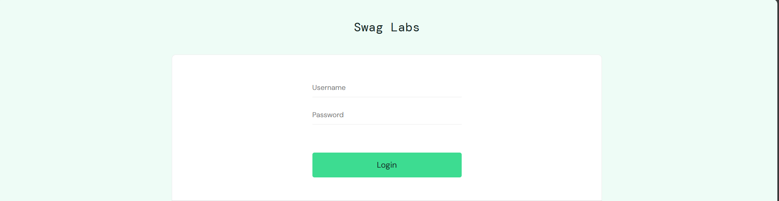
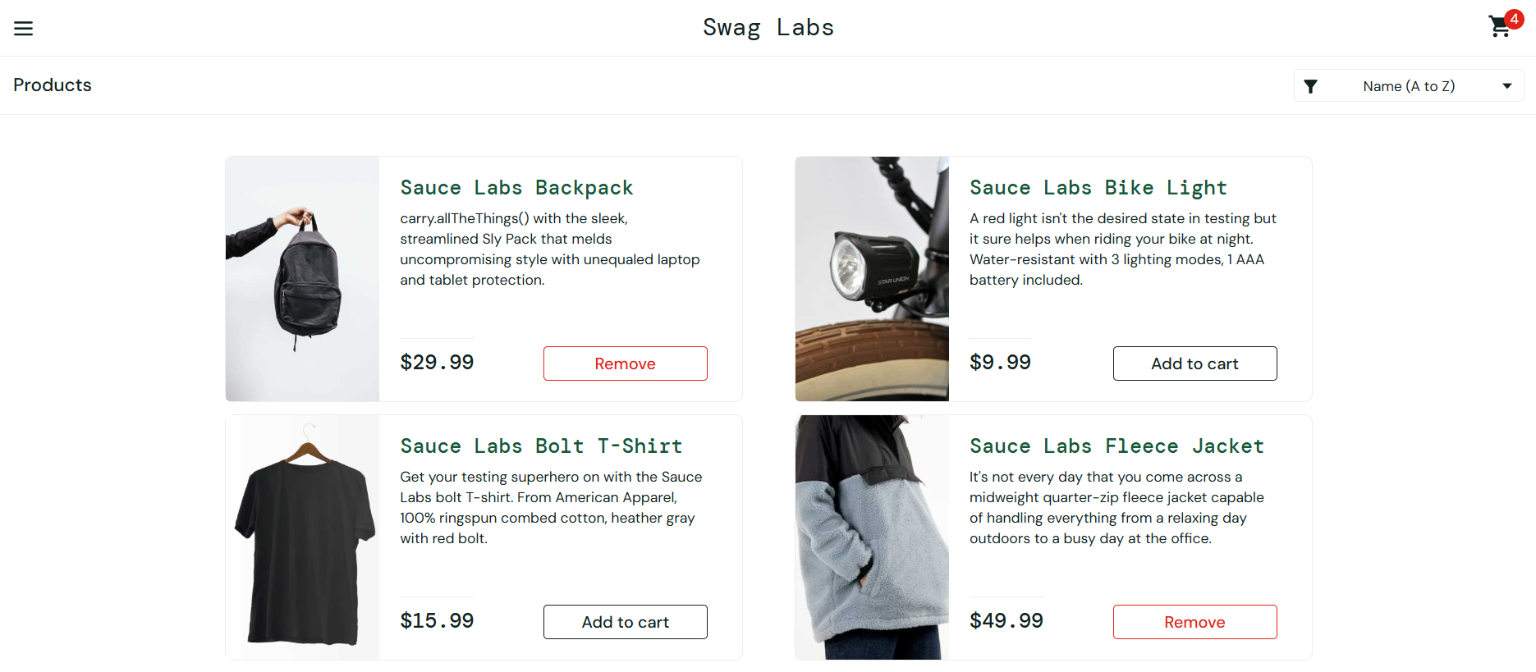
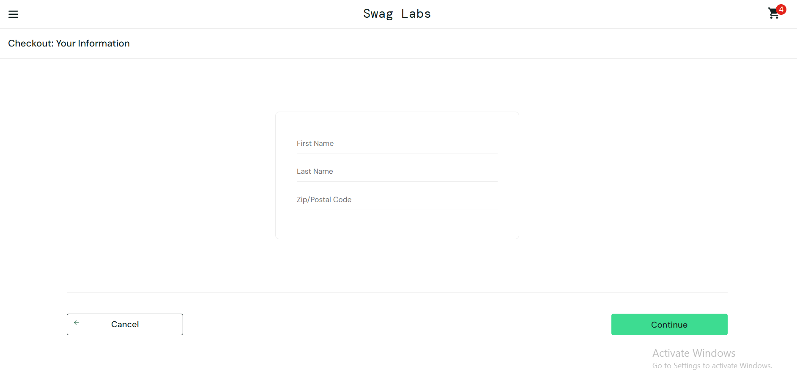
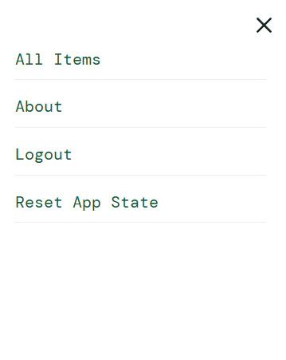
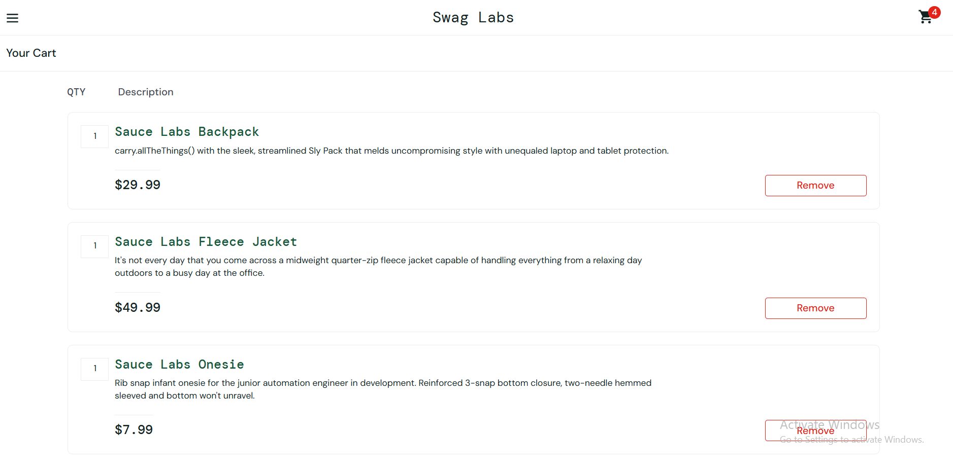
Menu Options Cart Checkout
Login
Select Products

Slide 4
End Users and Features:
Primary Users
Individual shoppers
QA/Test Engineers
Key Features & How the features solve the problems
User Authentication: Login with valid/invalid credentials
Product Listing: Displaying products, sorting options
Shopping Cart: Adding/removing items, updating quantity
Checkout & Payment: Checkout flow, order summary validation
Menu Options

Slide 5
Data Structure:
Backend uses a relational database (e.g., MySQL)
Key Entities: Users, Products, Cart Items , Orders , Order Items
Data flow: Login → Browsing Products → Cart Operations → Checkout

Slide 6
Programming Languages + Frameworks:
Languages:
Java
Frameworks/Tools:
Selenium WebDriver
TestNG
Maven
Testing Tools:
Postman (API)
Selenum

Slide 7
Live Application + Testing Summary
Live Application Status:
- Beta version online for manual
Environment: google chrome
Purpose: Designed for automation practice and QA testing scenarios
Access: Open for anyone (no signup needed), includes preset user accounts for varied test cases
Key Testing Phases Applied:
Integration Testing
Functional Testing
UI Testing
Unite Testing
System Testing

Slide 8
Deliverables Summary:
Documentation & Reports:
Test Plan Document
Test Cases (Excel Sheets)
Bug Reports
Test Summary
Requirements Documents

Slide 9
Project Team + Roles:
1- Kerollos Ashraf ( Team Leader )
2 -Abd El Rahman Ahmad (Tester )
3 -Kerollos Malak ( Tester )
4 -Nouran wailed ( Tester )
5- Adham ( Tester )
Collaboration methods : communication tools( WhatsApp - Zoom )

Slide 10
Thank You
Your opinion matters to us. Feel free to share any feedback
ashrafkerollos92@gmail.com
a4936119@gmail.com
Nouranwalied20102002@gmail.com
kiromina2003@gmail.com
abdoaseel222582@gmail.com

